Slide 1

TEAM TAMAD
Gene Paul Zafra

Slide 2
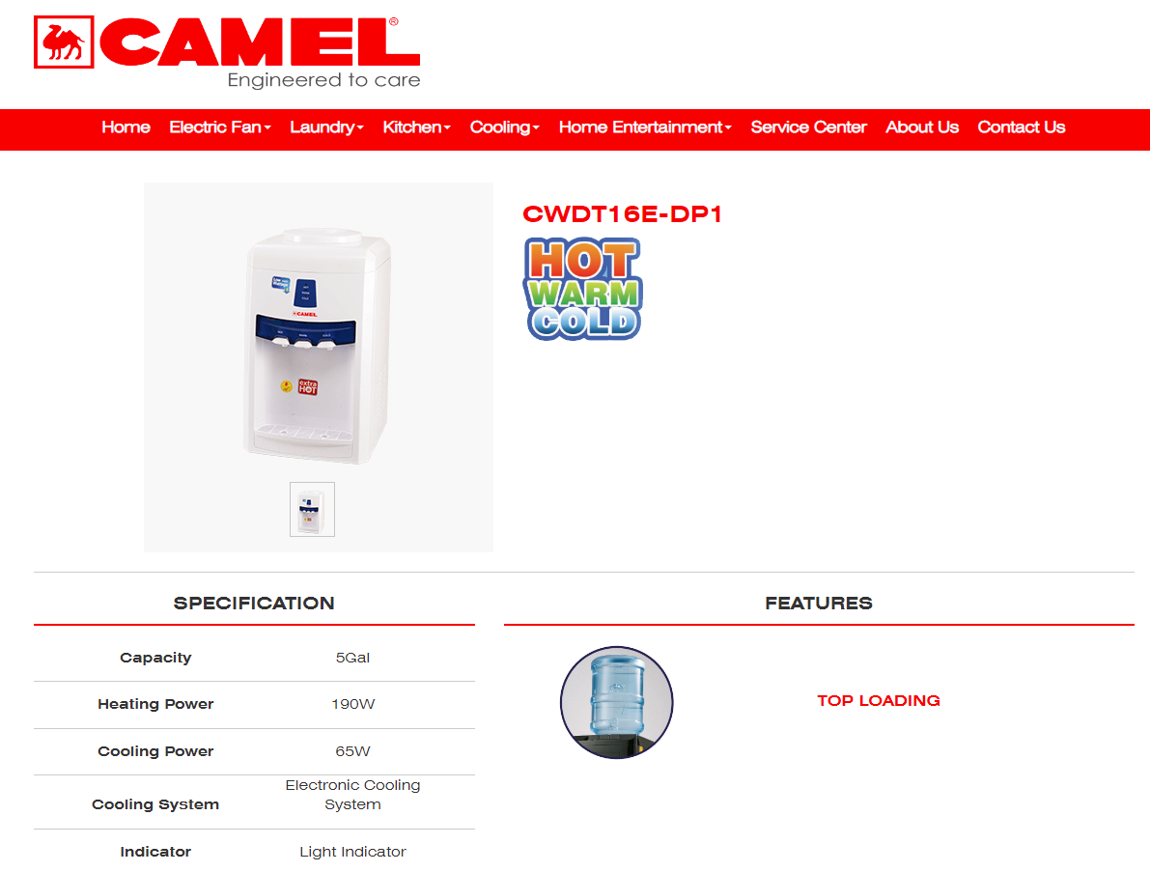

Slide 3
Usual temps for WATER in Refrigeration
Water is kept in cool 10-13 Degrees Celsius

Slide 4
Usual temps for WATER in Hot Water Dispensers
Water is kept in 80-94 Degrees Celsius

Slide 5
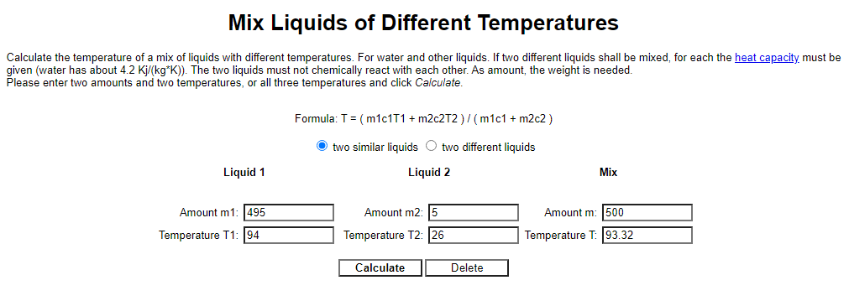

Slide 6
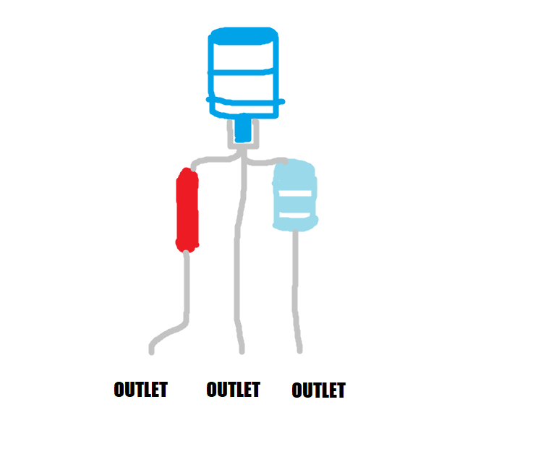
UPON DISASSEMBLY

